Slide 1

FINANCE QUANT PROJECT
MANSI GUPTA

Slide 2
Nifty Financial Services
Designed to reflect the behaviour of the Indian Financial Market which includes banks, housing finance and insurance companies.
Highest weightage in stock is by HDFC Bank
Data was available for 14/20 banks, etc that come under Nifty Financial Services.
Ticker Symbols were obtained by reading a csv file
Data was obtained from yahoo finance in python
Used google collab to code in python

Slide 3
My Strategy
I used a combination of the MACD indicator and the RSI indicator to generate more cautious buying and selling signals.
Initially tried using a volume indicator but the found the results to be unsatisfactory.
Hence focused on the use of price and built my strategy using technical indicators that take into consideration price.

Slide 4

MACD
Firstly it is a momentum indicator. Momentum in this context can be thought of as inertia and it deals with the speed at which a security’s price is actually changing.
It uses exponential moving averages which is a more enhanced version of simple moving averages(as weight is given to most recent data points)
It is a lagging indicator
Bullish signal –
Upward momentum
Bearish signal-
Downward momentum

Slide 5
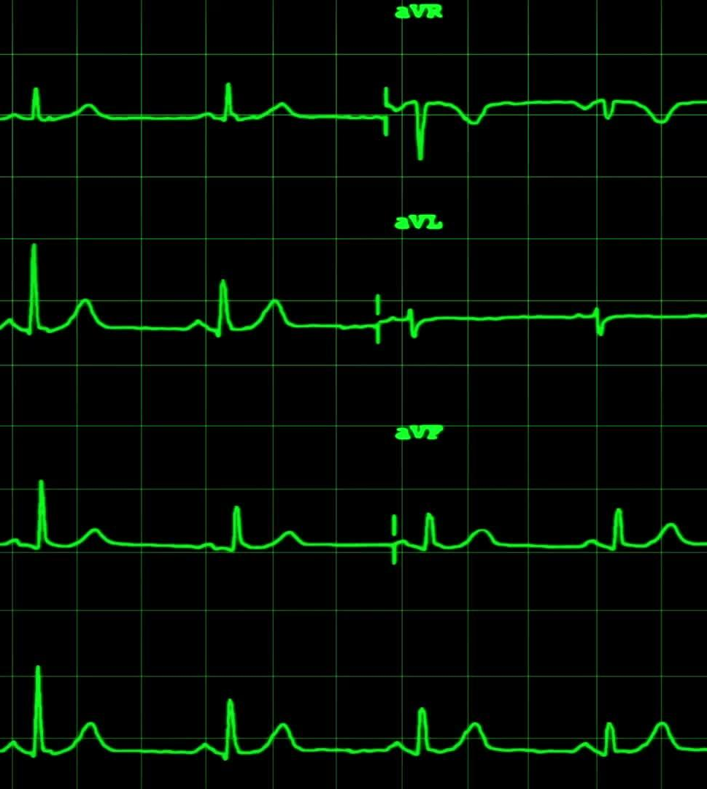
MACD line calculated by taking the difference of the 26 day EMA and 12 day EMA
Signal line obtained by taking 9 day EMA of the MACD line itself
Crossovers are looked for
In some cases Divergences are used to confirm or refute the trend after a crossover is observed.
Rapid falls and rises in MACD indicate the stock is being overbought or oversold hence entering the market can be risky.

Slide 6
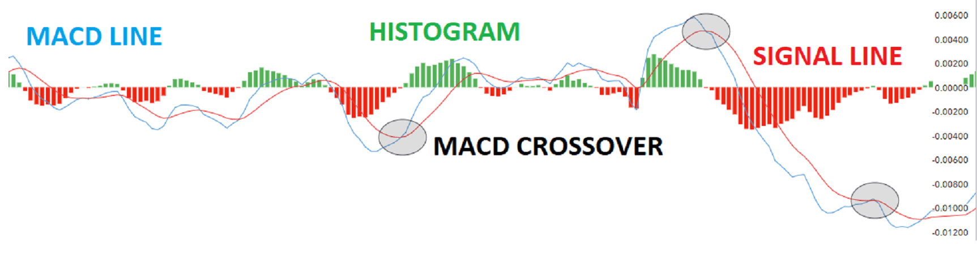
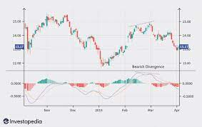
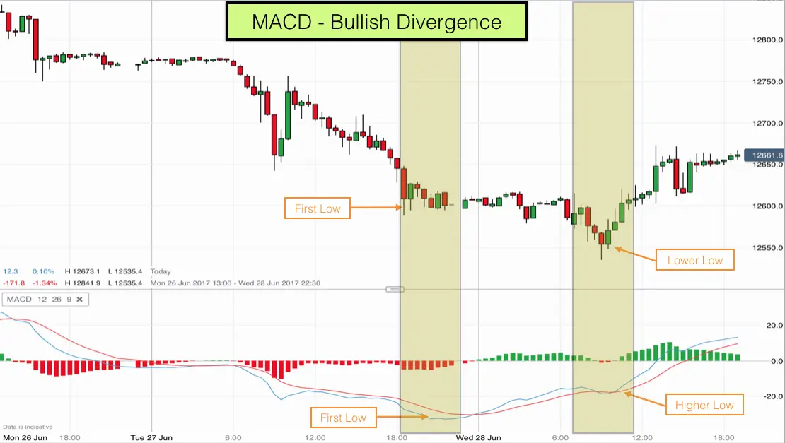

Slide 7
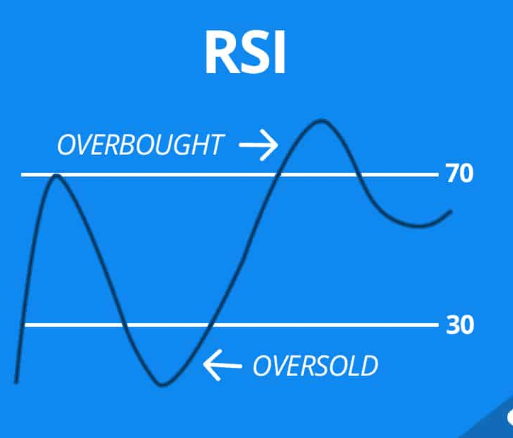
RSI
Based on average gains or losses during a lookback period(generally taken to be 14 days)
It rises as number and size of positive closes increases and it will fall as the number and size of losses increases.
Generally we look for moments when RSI crosses the 50 mark and in some cases we look for RSI divergences as well.

Slide 8
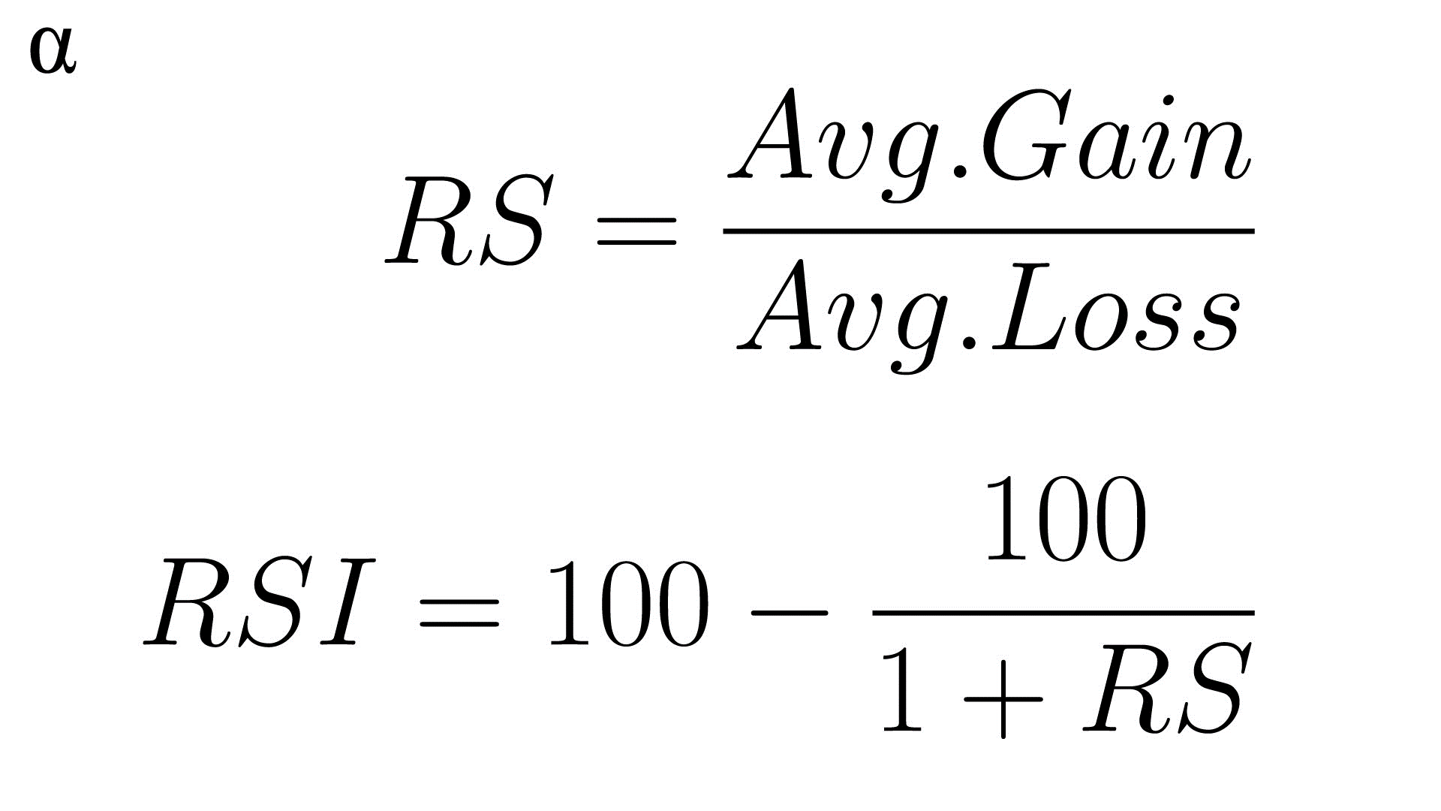
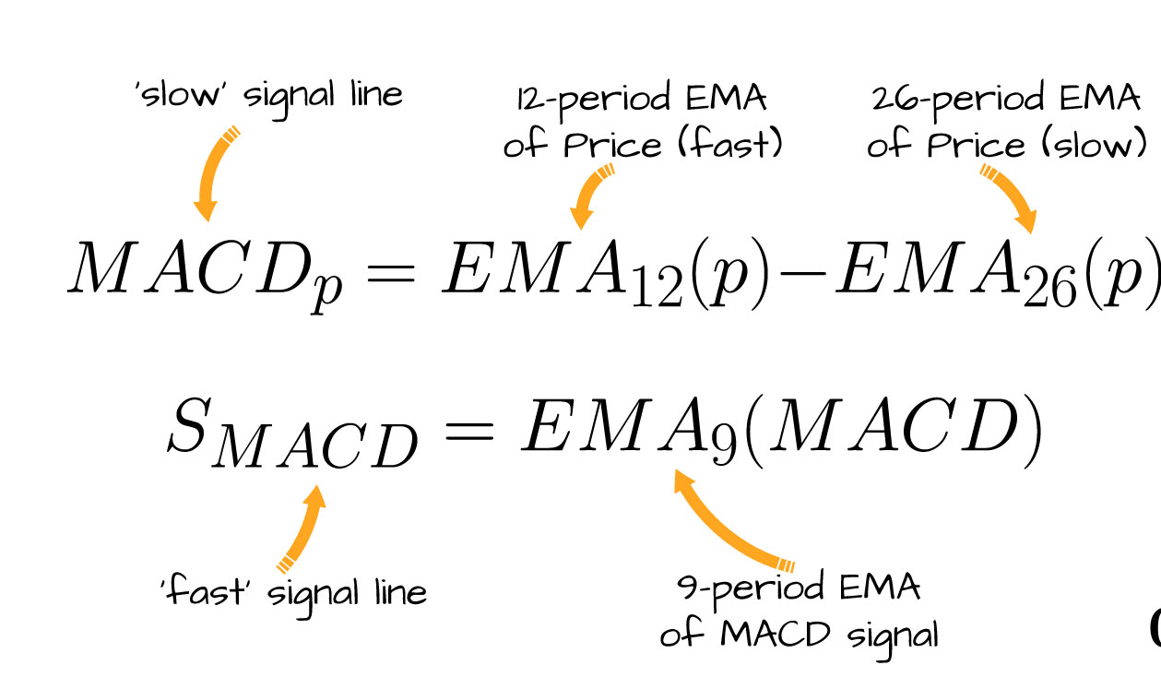
FORMULAE USED

Slide 9
Using MACD and RSI together
They give similar buying and selling signals hence entering a trade after confirmation from these indicators can help reduce the number of false signals.
Both are reliable and frequently used technical indicators and I thought the combination of the two will help produce more cautious buy and sell signals.
However there are cases when they might produce contradicting signals.

Slide 10
THE CODE AND CSV FILE USED:
https://colab.research.google.com/drive/1Ut_yLNpVhDnjr78D5487NQyodZ98Cckk?usp=sharing#scrollTo=Pcd2do7KORWG
/content/ind_niftyfinancelist.csv (kindly upload the csv file in the files section of the google collab notebook)

Slide 11
THANK YOU

